Slide 1
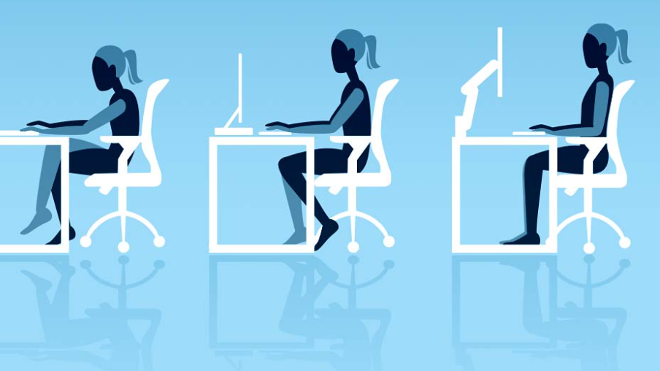
The Hazards of Sitting: An Osteopath’s Approach To Preventing Work-related injuries
Michele L. Lanning D.O.
May 5, 2023

Slide 2

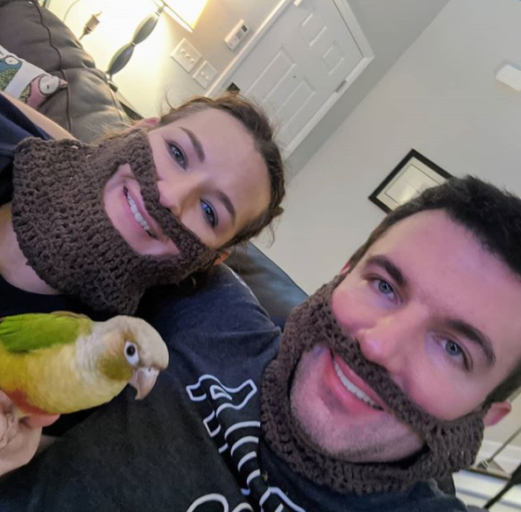
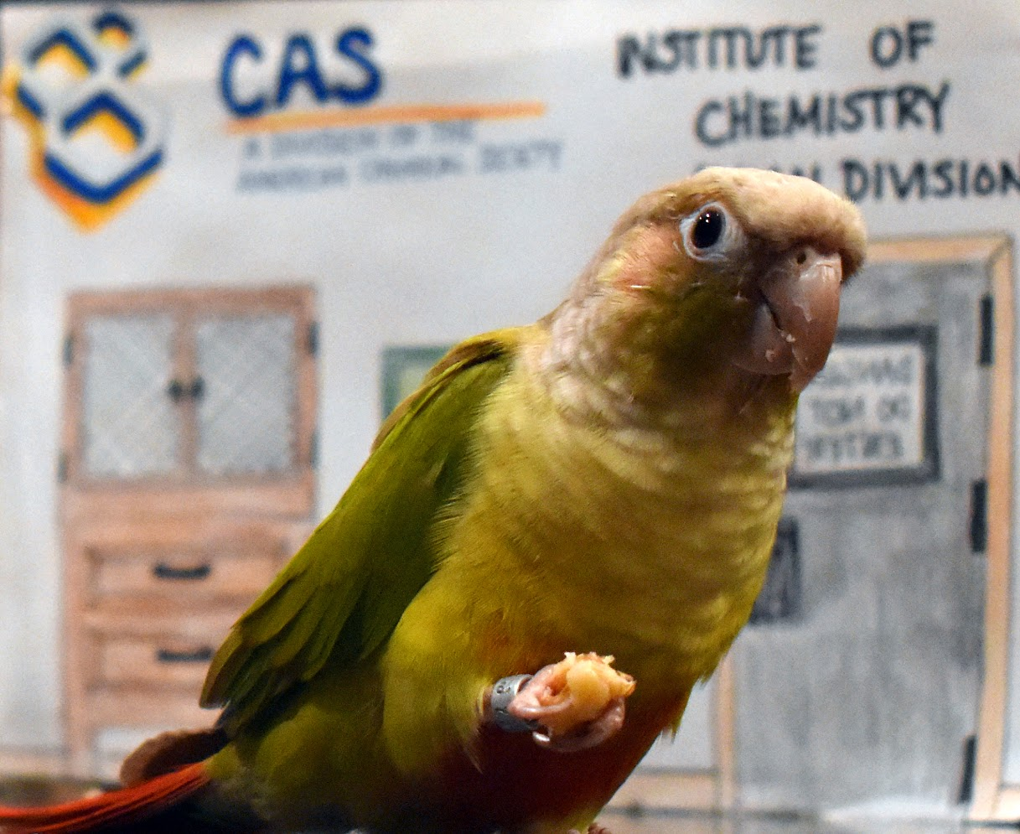


About this Osteopath..
Education
Married
Proud mother of two parrots
Willie and Bob Ross
Enjoy volunteering, outdoors, photography, baking, CBJ hockey

Slide 3

What is osteopathic Medicine?
Provides all the training and benefits of allopathic medicine (MD).
And It also offers the added benefit of hands-on diagnosis and treatment through a system of treatment known as osteopathic manipulative medicine or OMT.
It emphasizes helping each person achieve a high level of wellness by focusing on health promotion and disease prevention.
Would like to learn more:
https://www.aacom.org/become-a-doctor/about-osteopathic-medicine

Slide 4
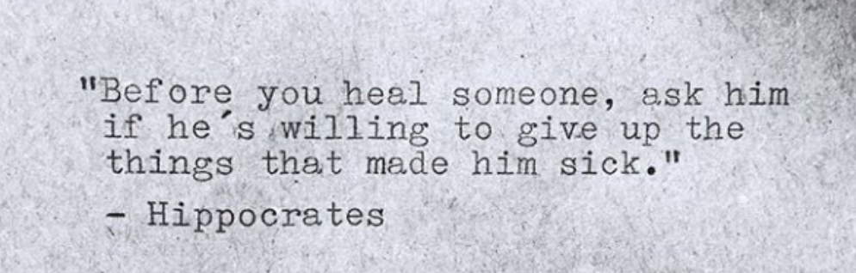
Why am I discussing this….
Work-related injuries are expensive to treat.
Employers pay up to $20 billion in worker compensation costs for these injuries, and associated disorder run as high as $50 billion/year.
And if not treated properly,
can lead to chronic pain.
Preventing injury
is the main goal.
Notes:
According to OSHA (Occupational Safety and Health Administration) , work-related musculoskeletal disorders, which include repetitive stress injuries (RSI), cost employers well over 600,000 lost workdays a year and account for $1 of every $3 spent for workers’ compensation.
Employers pay up to $20 billion in worker compensation costs for these injuries, and associated disorder run as high as $50 billion/year.

Slide 5
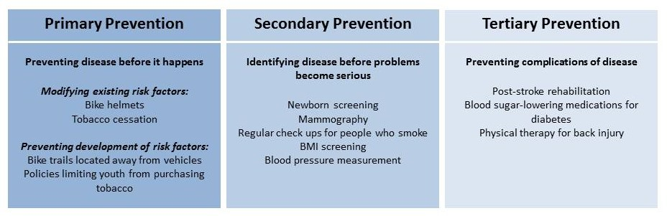
Levels of Intervention
Bottom line:
Physicians should try to identify patients in the primary prevention stage.
This has the most impact on the patient's overall health and lowers healthcare cost.
Notes:
Primary prevention
Aims to prevent disease or injury before it occurs.
Done by identifying and preventing exposures to hazards that lead to disease or injury, altering unhealthily/unsafe behaviors.
Example:
Education about healthy and safe habits
Secondary prevention
Aims to reduce the impact of a disease or injury that has already occurred
This is done by detecting and treating disease or injury as soon as possible to halt or slow its progress, encouraging personal strategies to prevent reinjury or recurrence, and implementing programs to return people to their original health and function to prevent long-term problems.
Tertiary prevention
Aims to soften the impact of an ongoing illness or injury that has lasting effects.
This is done by helping people manage long-term, often-complex health problems and injuries (e.g. chronic diseases, permanent impairments) in order to improve as much as possible their ability to function, their quality of life and their life expectancy.

Slide 6

The information in this presentation is not intended or implied to be a substitute for a professional medical opinion, diagnosis or treatment.
MEDICAL DISCLAIMER

Slide 7

But Before we get started….
Let’s all get up and stretch….

Slide 8
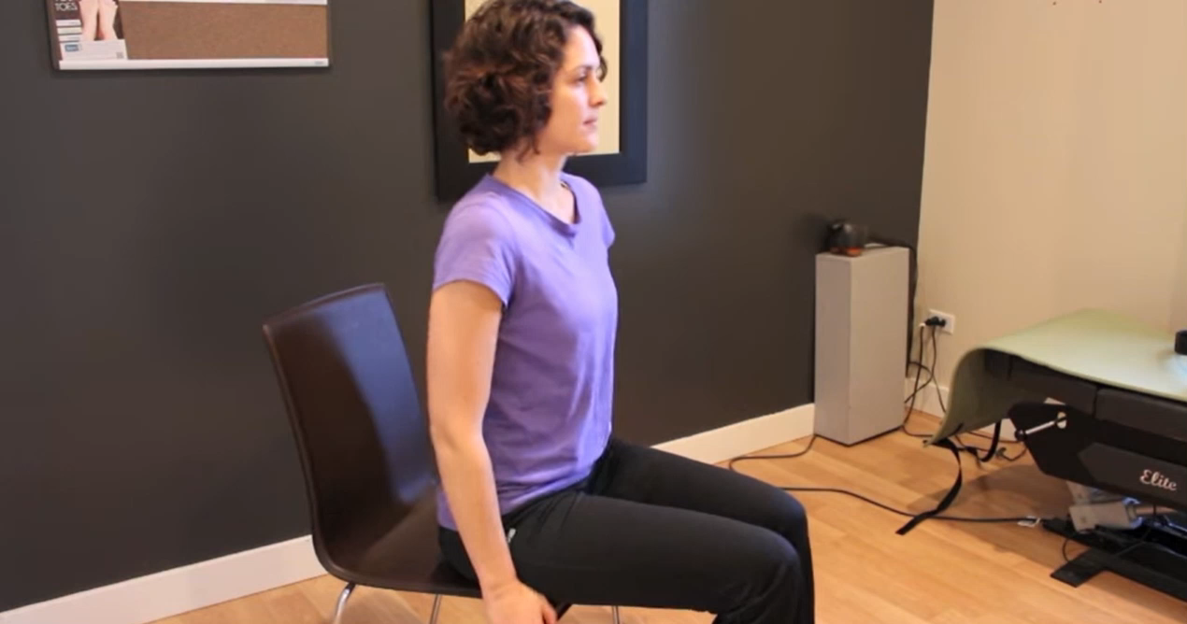
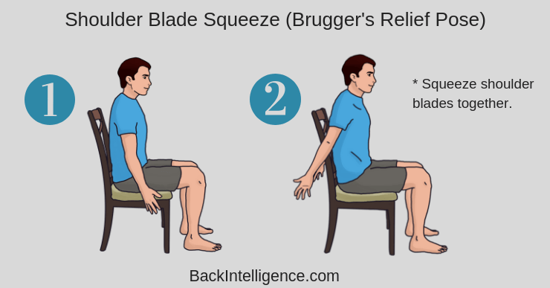
“Computer” back relief Exercise
Bruegger’s relief position
Try adopting the postural relief position every 20 mins.
Sit at the edge of your chair with your feet farther apart than your hips.
Turn your feet outward slightly.
Tuck your chin straight back slightly.
Breathe into your abdomen.
Actively exhale while
Extending your fingers and turning your palms outward
Raising your chest slightly
Repeat two to three times.
Try doing the same movements while standing.
If you practice the postural relief position conscientiously, within a few weeks you should feel yourself sitting taller in your chair, with decreased muscle tension and fatigue.
Notes:
https://youtu.be/TP0X8wITwmI?t=35

Slide 9
Objectives
Basic Workstation Setup
Why is Office Ergonomics important?
Office ergonomics using A.R.M.S acronym.
Choosing the Right Chair.
Chair Adjustment.
Hazards of Sitting
Repetitive Stress Injuries – RSI
Full Body Stretching Routine to Combat RSI
Eye Strain Prevention.
Additional Tips.
When to seek medical advice.
Key Takeaways
Notes:
Most Common Work-related injuries: Repetitive Stress Injuries (RSI)
Basic information about each injury and preventative measures.
Basics Steps for preventing computer related injuries.
When to seek additional help.

Slide 10

Workstation setup: An Essential part of starting your day Right.
Proper office ergonomics with A.R.M.S.

Slide 11
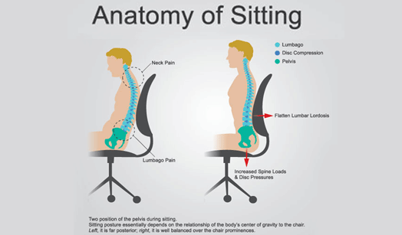
Desk Posture is important
Poor posture is the root cause of muscle spasms, fatigue and back pain.
However, what is “right” or “good” posture?
It is when the muscles surrounding the spine are balanced, symmetrically aligned and supporting the entire body equally.
Why does this matter?
Good or right posture is a core pillar of our overall health.
Assures the correct alignment and facilitates proper distribution of tension in muscles and ligaments which reduces stress.
Notes:
It assures the correct alignment of the bones and facilitates proper distribution of tension in muscles and ligaments.
Reduces stress by keeping body parts in their right position.

Slide 12

Why is office Ergonomics important?
Refers to the way a worker functions in an office setting.
2 out of 3 individuals experience neck pain at some point, with symptoms lasting up to 3 months.
1 in 3 have suffered pain wrist due to work, with up to 12% reporting difficulty everyday.
Work shouldn’t hurt.
Fortunately, the solution is simple.
Notes:
https://www.cmd-ltd.com/advice-centre/ergonomics/workers-guide-to-office-ergonomics/
Proper workstation setup and work practices can eliminate discomfort and even prevent it from occurring in the first place! Simple adjustments to office equipment can work wonders, making work more comfortable and more productive.

Slide 13
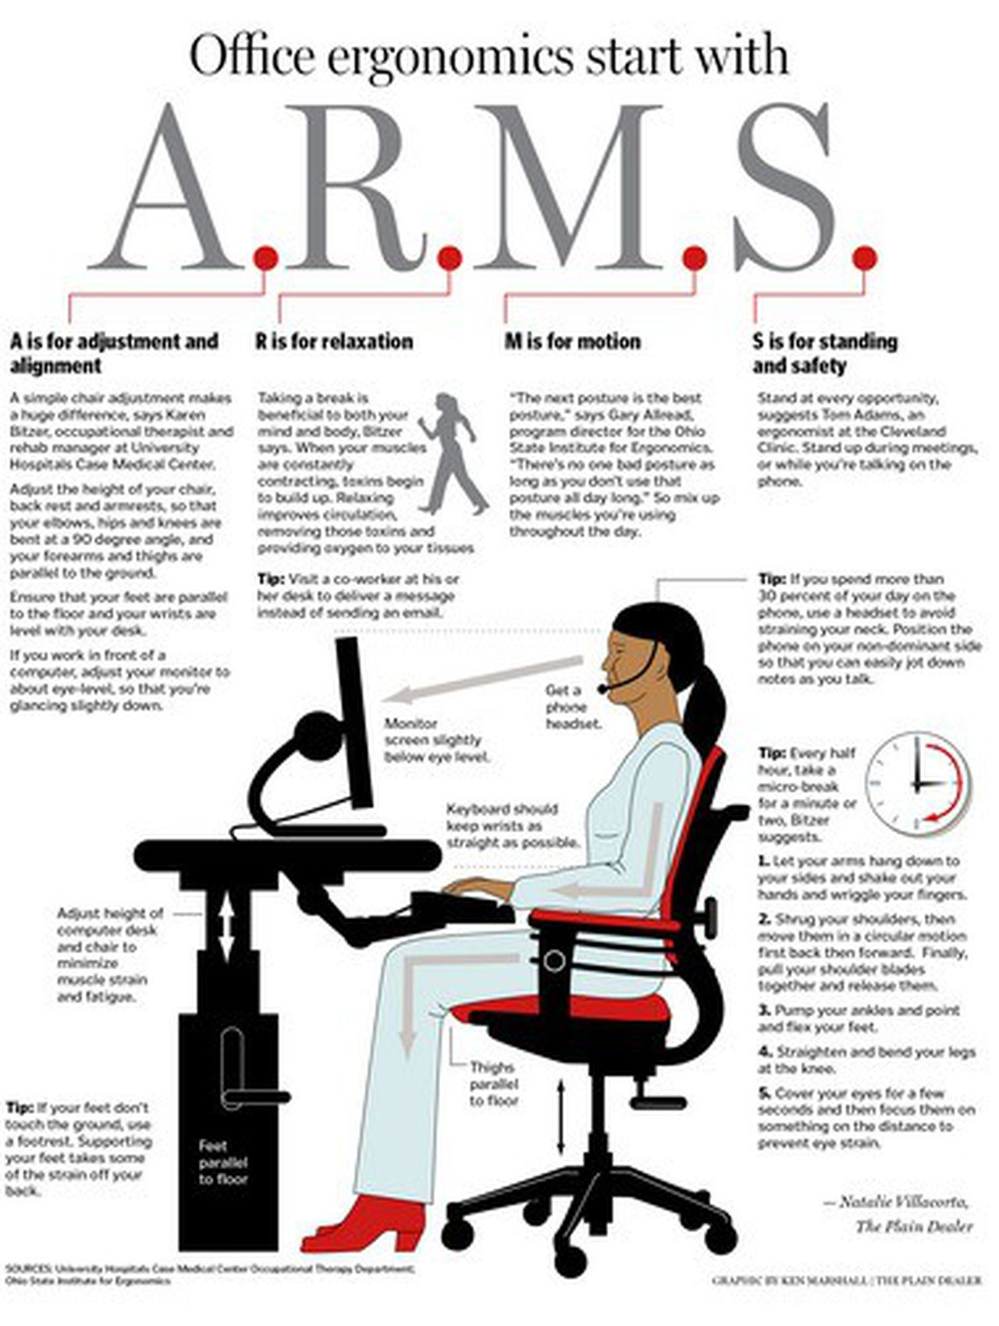
What is A.R.M.S?
A: is for adjustment and alignment.
Chair adjustment.
Monitor, mouse and keyboard placement.
R: is for relaxation.
Incorporating regularly scheduled breaks.
M: is for motion.
Don’t stay in a position for too long.
S: is for standing and safety.
Incorporating standing at every opportunity and when appropriate and if able.

Slide 14
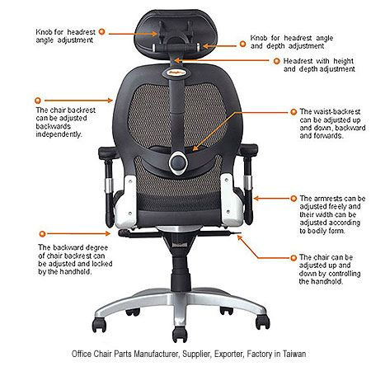
Choosing the right chair
Most important piece of the ergonomic workstation.
We spend up 8 – 15 hours daily.
A good chair and setting it up properly is important.
A seat height ranging from 16 to 21 inches off the ground is suitable for most workers.
Notes:
Here are the most important factors to consider:
Height – You should be able to sit with your feet flat on the floor and your thighs roughly parallel to the floor. If you need a taller chair in order to reach a too-tall desk, use a foot rest to get the right leg angle.
Backrest Recline and Tilt – To reduce stress in your spine, an office chair that reclines and tilts with tension control are absolutely critical. Research has shown that a reclined seat significantly reduces the pressure on your back, and is particularity beneficial for people with back pain. Look for chairs that can recline at least 135 degrees back with synchronous tilt.
Lumbar support – the shape of the backrest should have a natural curve to support your lower back. Think Birkenstocks for your back. Consider using a lumbar support pillow if your chair lacks proper lumbar support.
Seat depth – For fixed seats, the ideal depth is 16.5″, and 14-18.5″ for adjustable seats (source).
Arm rests – Look for armrests that are not just height adjustable, but can pivot inwards to support the entire length of your forearm when performing certain tasks such as keyboarding.
Material – Try to find a comfortable amount of cushioning: your chair should feel supportive without being overly hard. Look for breathable or mesh fabric.

Slide 15
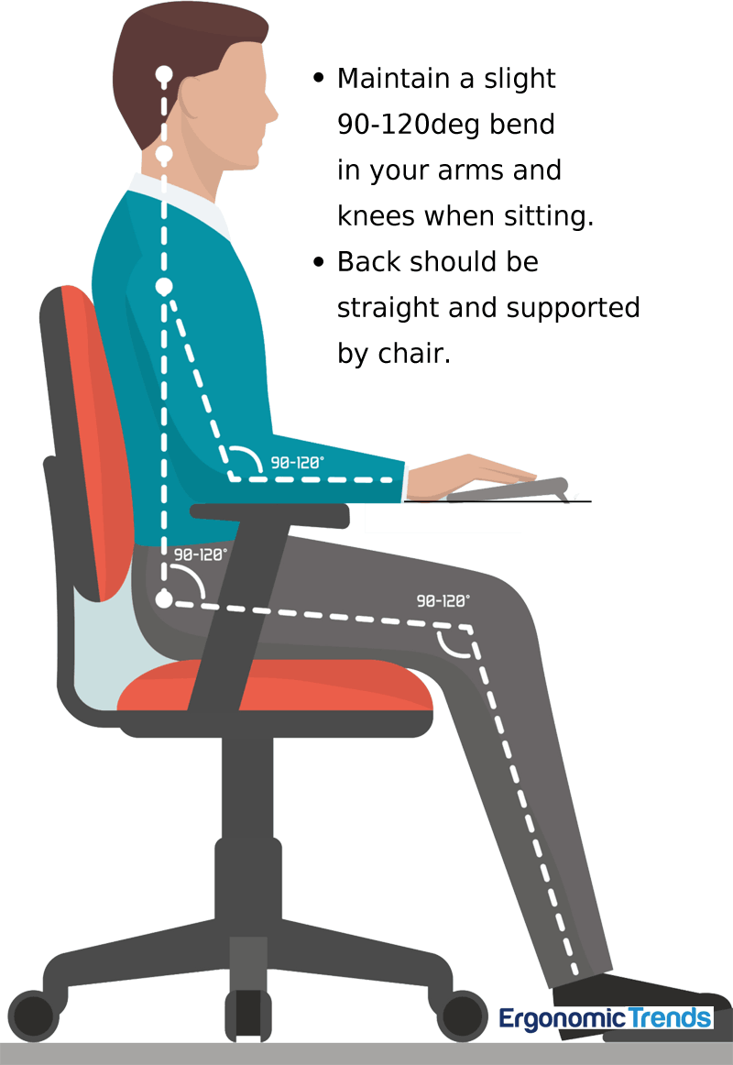
A: adjustment and alignment: Chair Adjustment
Elbows, hips and knees are bent at 90-degree angle, and your forearms, and thighs are parallel to the ground.
Feet touch the ground and are flat as well as parallel to the floor and your wrists are level with your desk.
If your feet don’t touch the ground, consider using a footrest.
Adjust your monitor to about eye-level, so that you are glancing slightly down.
Notes:
https://ergonomictrends.com/creating-perfect-ergonomic-workspace-ultimate-guide/

Slide 16
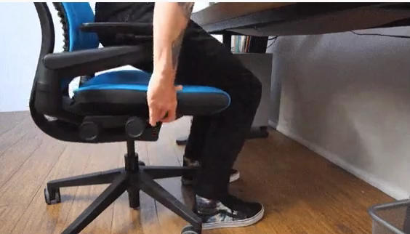
Adjust the HEIGHT
Sit down and adjust the height of the chair so your feet are flat on the ground and your legs form a 90-degree angle.
Your knees should align with or rest slightly lower than your hips.
Quick Tips:
If you start to notice increased pressure near your bottom, raise the height slightly.
If you feel pressure at the front of your legs, lower the chair slightly.
Notes:
Adjust the height
Sit down and adjust the height of the chair so your feet are flat on the ground and your legs form a 90-degree angle.
Your knees should align with or rest slightly lower than your hips.
Quick Tips:
if you start to notice increased pressure near your bottom, raise the slightly.
If you feel pressure at the front of your legs, lower the chair slightly.
Adjust the seat depth
If you chair allows, you can adjust the depth of the seat- where you sit in relation to the backrest of the chair.
Sit on the chair and keep your feet flat on the floor, then check that the clearance between the seat and your calves fits a clenched fist.
Quick Tips:
If the front of the seat is digging into the back of your knees, slide the seat back slightly.
If you have too much room and your knees are sticking out, slide the seat forward slightly.

Slide 17
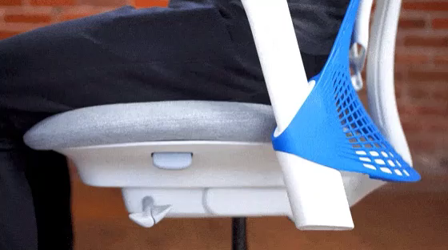
Adjust the seat depth
If your chair allows, adjust the depth of the seat where you sit in relation to the backrest of the chair.
Sit on the chair and keep your feet flat on the floor, then check that the clearance between the seat and your calves fits a clenched fist.
Quick Tips:
If the front of the seat is digging into the back of your knees, slide the seat back slightly.
If you have too much room and your knees are sticking out, slide the seat forward slightly.

Slide 18
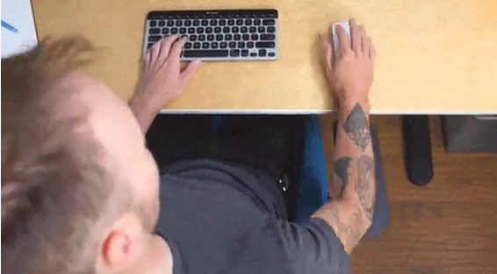
Adjust the arm rests
Adjust the height of the arm rests so they’re at elbow height with your shoulders relaxed, and your arms are at a 90-degree angle.
If the arms slide in or out move them so they support whatever work you’re doing.
Quick Tips:
For example, slide them in when you’re typing out a long email on a keyboard, then slide one out when you’re working more with the mouse.
It’s good to get in the habit of adjusting your armrests as you change tasks as well.
Notes:
https://www.nytimes.com/wirecutter/blog/how-to-adjust-office-chair/
Adjust the arm rests
Adjust the height of the armrests so they’re at elbow height with your shoulders relaxed, and your arms are at a 90-degree angle.
If the arms slide in or out move them so they support whatever work you’re doing.
For example, slide them in when you’re typing out a long email on a keyboard, then slide one out when you’re working more with the mouse
It’s good to get in the habit of adjusting your armrests as you change tasks as well.
Adjust the recline and tilt tension
Adjust the tension so you can lean back in the chair comfortably without using a lot of force, and make sure the chair doesn’t spring upright too strongly when you lean forward.
If you can’t lean back without forcibly pushing, loosen the tension. If you find yourself using your core to pull yourself out of the chair when it’s tilted back, tighten the tension.

Slide 19
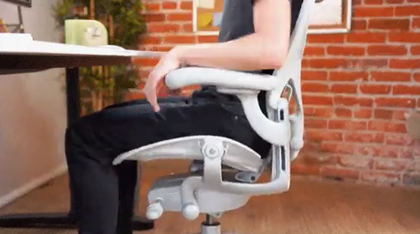
Adjust the recline and tilt tension
Adjust the tension so you can lean back in the chair comfortably without using a lot of force, and make sure the chair doesn’t spring upright too strongly when you lean forward.
Quick Tips:
If you can’t lean back without forcibly pushing, loosen the tension.
If you find yourself using your core to pull yourself out of the chair when it’s tilted back, tighten the tension.

Slide 20
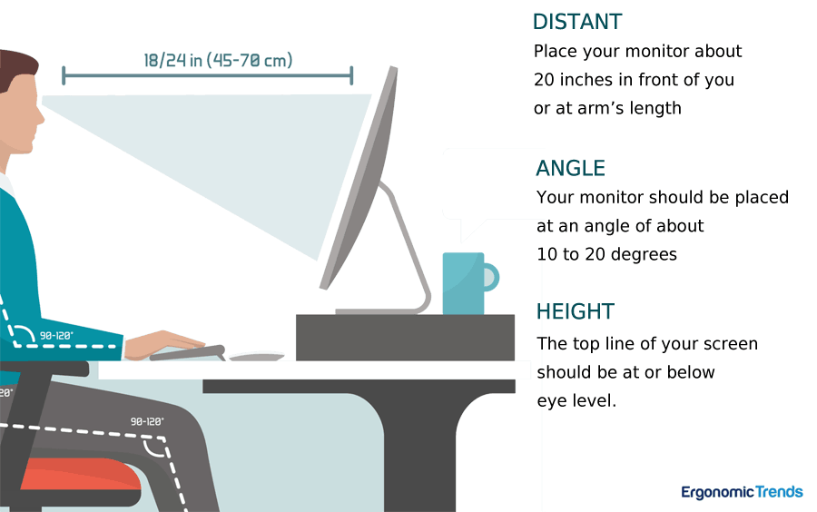
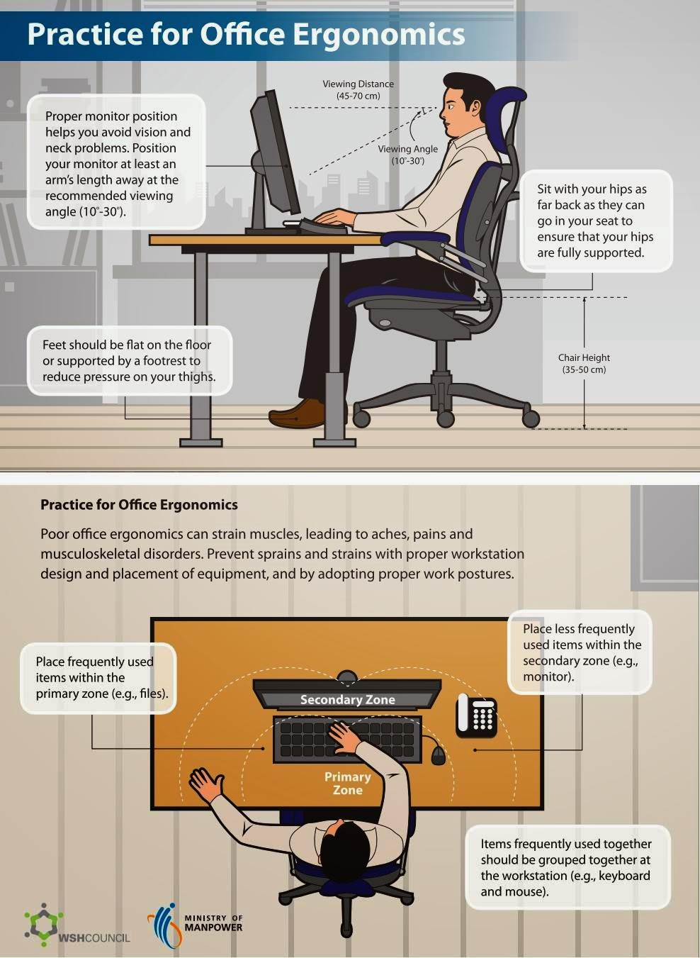
A: Adjustment and alignment: Workstation setup
Organize your workstation into zones.
Primary zone
Where you can easily reach just by moving your forearms horizontally, with your elbows remaining comfortably near your sides.
Dedicated to your keyboard and mouse.
Secondary zone
Reachable by extending your arms but without leaning or bending at the waist.
Reference books, notebooks, or stationary.
Tertiary Zone
Adjust your monitor height and tilt.
Notes:
The first zone is where you can easily reach just by moving your forearms horizontally, with your elbows remaining comfortably near your sides. This area is normally dedicated to your keyboard and mouse. Nothing else should be in this zone unless you use it as much as your mouse and keyboard.
The next zone is reachable by extending your arms but without leaning or bending at the waist. This is a good area for things you use frequently such as reference books, notebooks or stationar you refer to often.
The third zone is reachable by extending the arms and bending or leaning at the waist. Although you can reach this zone without standing up, it’s not comfortable to do so frequently. This is a good area for things that you use just occasionally.
If your work area extends beyond this zone (for example, vertical shelving above your desk) it should be used for storage only.

Slide 21
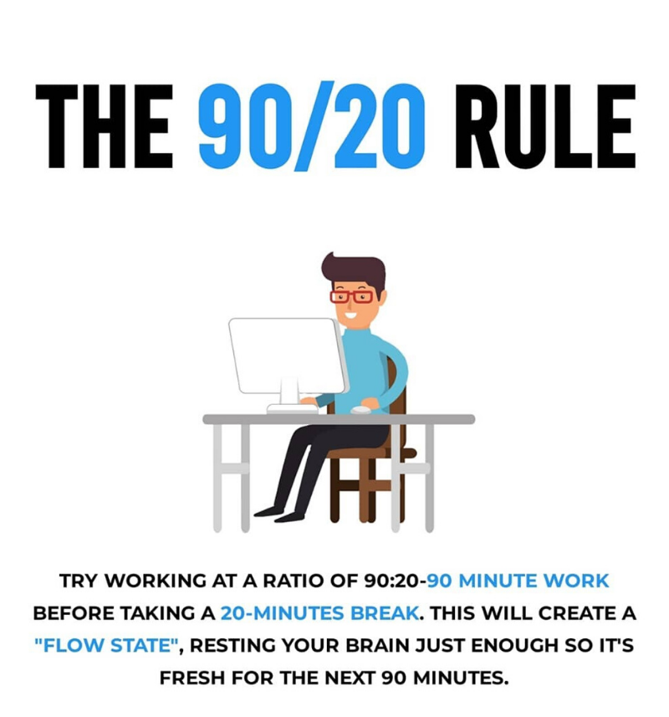
R: Relaxation
Take regularly scheduled breaks during your workday.
Try the 90/20 rule.
Frequent short breaks are better for your back then few longer ones.
It gives the muscles a change to relax while others take the strain.

Slide 22
M: Motion
“The next best posture is the best posture.”
Goal mix up the way you sit throughout the day.
This allows for the strained muscles to relax and relaxed muscles to carry the burden.

Slide 23
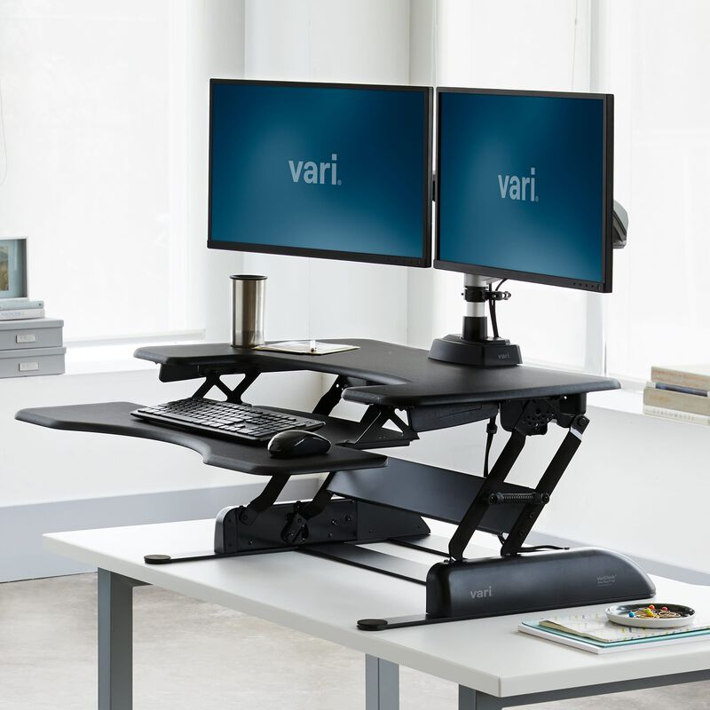
S: Standing and safety
Stand up at every opportunity, if able.
Meetings, phone calls.
Goal: Add variability to your workday.
Use a standing desk or convert your desk.
Elevate your desk and work standing for 1-2 hour/day.

Slide 24
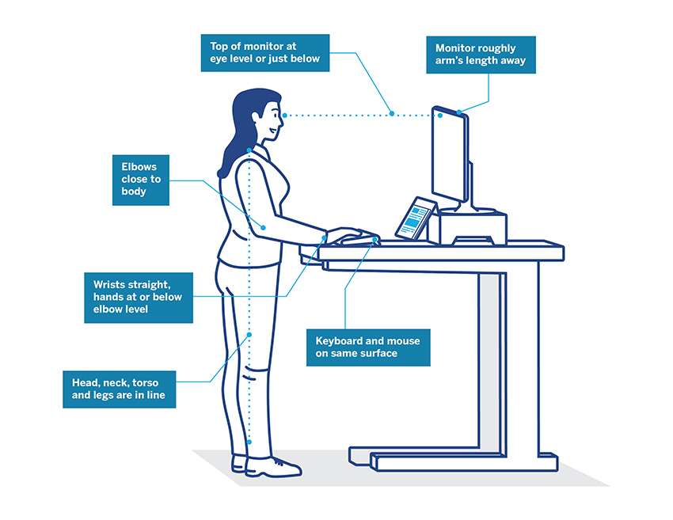
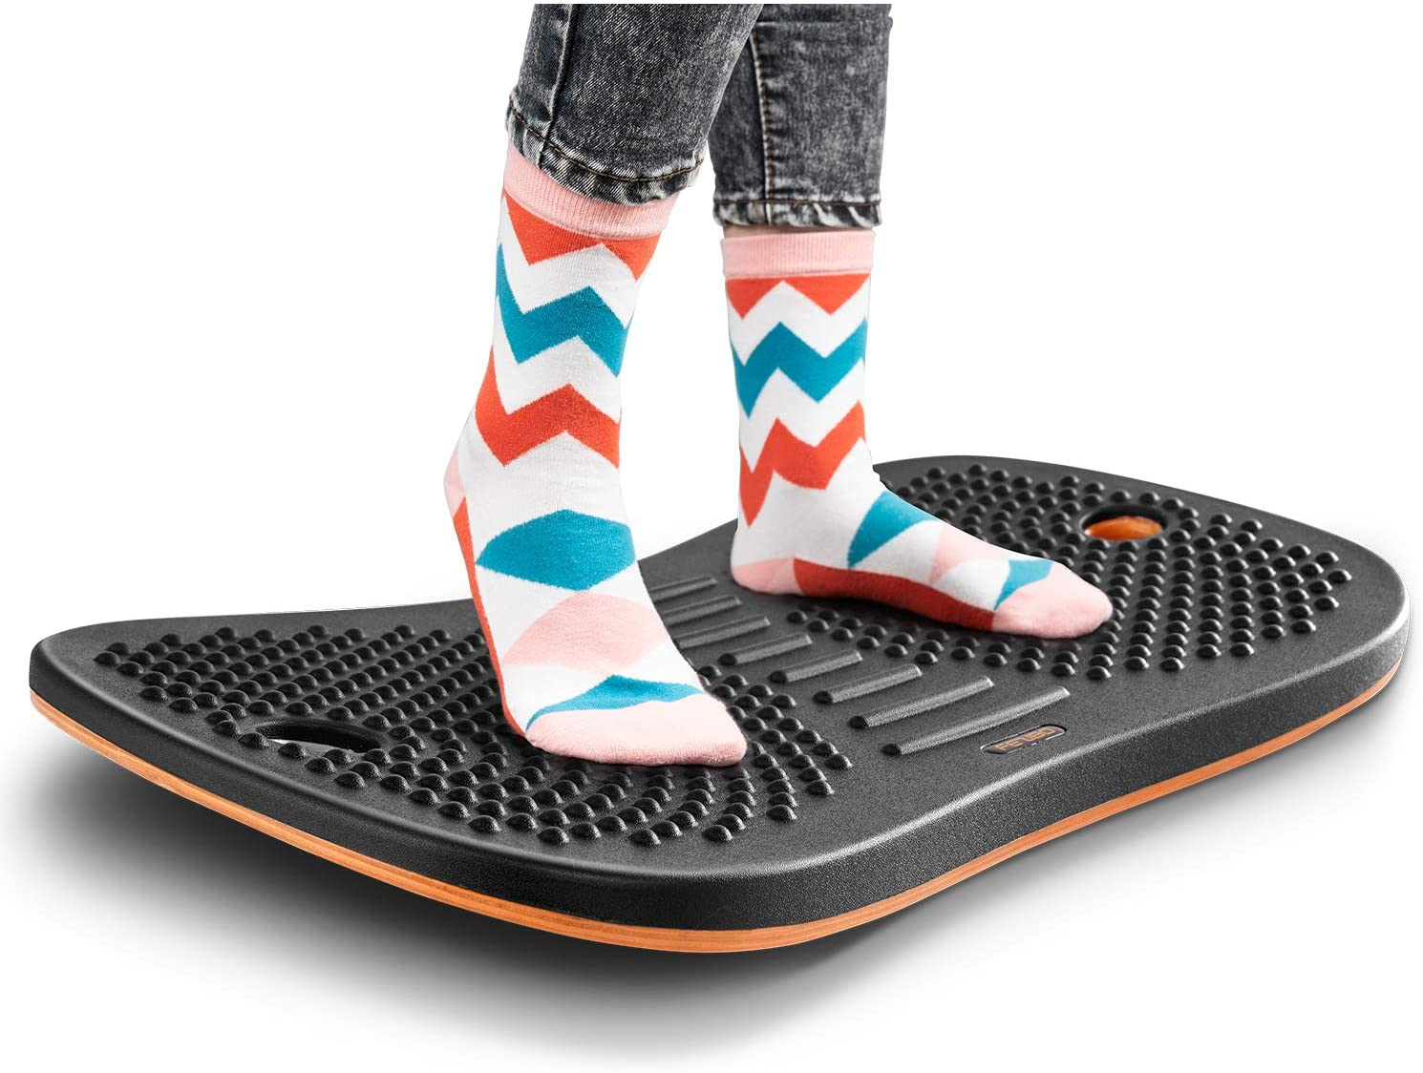
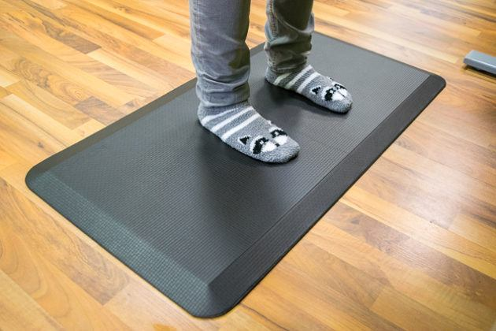
Tips for maintain good standing Posture
Alternate positions to alleviate pressure on the feet/legs and promote blood flow.
Use a cushioned mat and foot-rest to avoid pain and fatigue in feet, legs, and back.
Tips for maintaining good standing posture

Slide 25
Hazards of sitting
Repetitive stress injuries and how excessive and improper sitting affects the body.

Slide 26
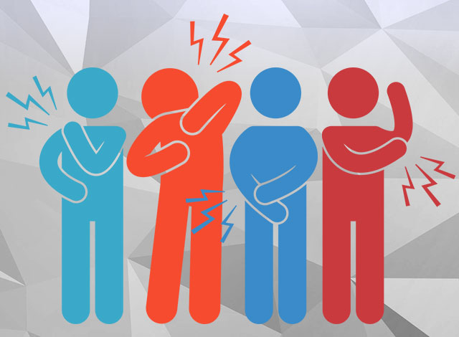
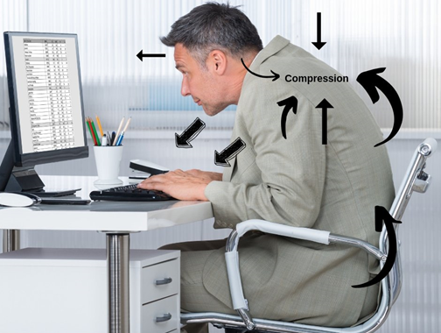

Repetitive Stress Injuries (RSI): A Result of excessive and improper sitting
Also known as overuse injuries.
Common among those who work at a computer.
Occurs when too much stress occurs from repeating the same movement repeatedly.
This can be either from proper or improper form.
This produces a gradual buildup of damage to muscles, tendons, and nerves from repetitive motions.
Causes: Inflammation (pain and swelling), muscle strain/sprain, and tissue damage.
Notes:
https://www.ncbi.nlm.nih.gov/pmc/articles/PMC7345456/

Slide 27
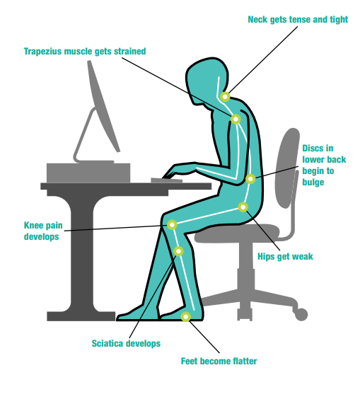
How excessive and improper sitting Affects the Body
Symptoms that result:
Headaches.
Excessive muscle tension.
Muscle strain and trigger points.
Joint dysfunction of the neck back and ribs cage.
Increased loading on the intervertebral discs.
Impaired function of your muscle of respiration (diaphragm).

Slide 28
Full body Stretching Routine to combat RSI
A simple stretching routine you can incorporate at your desk or at home.

Slide 29
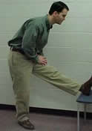
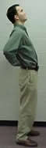
Warming up for work
Just as an athlete prepares before playing, you too should prepare your body for the stress of sitting.
These stretches help prevent back injuries and make the muscles more flexible.
Hold each position for 20 seconds and repeat 3 times prior to work.
You can also perform these stretches to ‘cool’ down at the end of you workday.
Notes:
https://ors.od.nih.gov/sr/dohs/HealthAndWellness/Ergonomics/Pages/exercises.aspx#Warming

Slide 30
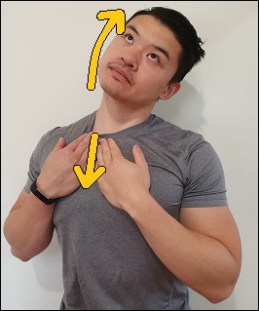
Sternocleidomastoid (SCM) Stretch
Place your fingers on top of your right collar bone.
Pull the skin downwards.
Tuck your chin in and down.
Slowly turn your head towards the right side.
Tilt your head towards the left.
Aim to feel a stretch on the right Sternocleidomastoid.
Hold for 30 seconds.
Repeat on other side.
Notes:
https://ors.od.nih.gov/sr/dohs/HealthAndWellness/Ergonomics/Pages/exercises.aspx#Warming

Slide 31
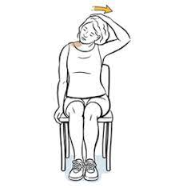
Neck-Upper Trap Stretch
Start in a sitting position, with your back straight and shoulders back.
Reach down and grab the side of the chair with the right hand.
Gently pull while tilting your head to the left, feeling a stretch down the right side of the neck and shoulder.
Hold for 10 to 30 seconds and repeat on the other side.
Repeat five to 10 times on each side.
Notes:
https://www.healthline.com/health/deskercise#head-and-shoulders
https://www.nhs.uk/live-well/exercise/sitting-exercises/

Slide 32
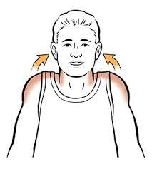
Shoulder Shrug
Sit or stand with your back straight and your shoulders back.
Lift the shoulders up towards the ears, squeezing them as hard as you can.
Hold for 1 to 2 seconds and roll them back as you relax down.
Repeat for 8 to 10 reps.
End the exercise by rolling the shoulders forward and backwards several times.
Notes:
https://www.healthline.com/health/deskercise#head-and-shoulders
https://www.nhs.uk/live-well/exercise/sitting-exercises/

Slide 33
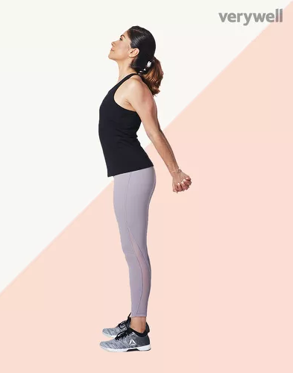
Chest Stretch
Stand with your feet shoulder-width apart. You can also perform this exercise seated in a chair.
Move your arms behind you and, if you can, lace your fingers together.
Straighten the arms and gently lift your hands up a few inches until you feel a stretch in your chest.
Hold for 10 to 30 seconds.
Repeat 5-10 times.
Notes:
https://www.healthline.com/health/deskercise#arms
https://www.google.com/imgres?imgurl=https%3A%2F%2Fi.ytimg.com%2Fvi%2F3g95hw1QMmY%2Fmaxresdefault.jpg&imgrefurl=https%3A%2F%2Fgmb.io%2Fshoulder-mobility%2F&tbnid=wHlJ7erLFyF1fM&vet=12ahUKEwjXvffjxsP0AhUOWq0KHRrpBfEQMygHegUIARDDAg..i&docid=Y-03gZrwwUIO3M&w=1280&h=720&q=exercise%20that%20can%20be%20done%20at%20your%20desk%20for%20shoulder%20mobility&ved=2ahUKEwjXvffjxsP0AhUOWq0KHRrpBfEQMygHegUIARDDAgAt desk: https://youtu.be/eRafOyVq2H8
At home: https://youtu.be/HNbQHHV8co0?t=8

Slide 34
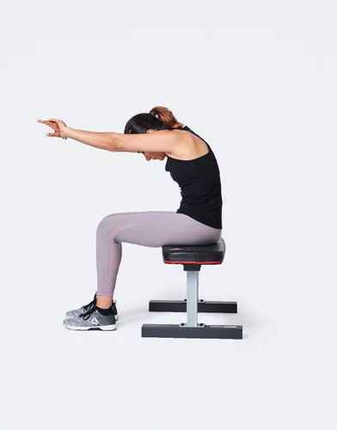
Upper back Stretch
Start in a seated or standing position.
Stretch the arms straight out and rotate the hands so that the palms face away from each other.
Cross the arms so that the palms are pressed together and clasp fingers together. If twisting the arms doesn't feel good, simply lace the fingers together.
Contract the abs and round the back, reaching away with your arms as you relax the head down.
Don't collapse but, instead, imagine you're curving up and over an imaginary ball.
Hold the stretch for 10 to 30 seconds.
Notes:
https://www.healthline.com/health/deskercise#arms
https://www.google.com/imgres?imgurl=https%3A%2F%2Fi.ytimg.com%2Fvi%2F3g95hw1QMmY%2Fmaxresdefault.jpg&imgrefurl=https%3A%2F%2Fgmb.io%2Fshoulder-mobility%2F&tbnid=wHlJ7erLFyF1fM&vet=12ahUKEwjXvffjxsP0AhUOWq0KHRrpBfEQMygHegUIARDDAg..i&docid=Y-03gZrwwUIO3M&w=1280&h=720&q=exercise%20that%20can%20be%20done%20at%20your%20desk%20for%20shoulder%20mobility&ved=2ahUKEwjXvffjxsP0AhUOWq0KHRrpBfEQMygHegUIARDDAgAt desk: https://youtu.be/eRafOyVq2H8
At home: https://youtu.be/HNbQHHV8co0?t=8

Slide 35
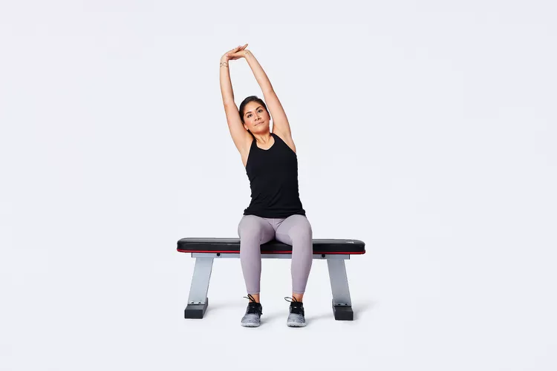
Overhead reach, or latissimus stretch
Start in a seated or standing position.
Lace the fingers together and stretch them up towards the ceiling.
Take a deep breath as you stretch up as high as you can.
You can also lean to the right and to the left to stretch your sides.
Exhale and open the arms, sweeping them back down.
Repeat for 8 to 10 reps.
Notes:
https://www.healthline.com/health/deskercise#arms
https://www.google.com/imgres?imgurl=https%3A%2F%2Fi.ytimg.com%2Fvi%2F3g95hw1QMmY%2Fmaxresdefault.jpg&imgrefurl=https%3A%2F%2Fgmb.io%2Fshoulder-mobility%2F&tbnid=wHlJ7erLFyF1fM&vet=12ahUKEwjXvffjxsP0AhUOWq0KHRrpBfEQMygHegUIARDDAg..i&docid=Y-03gZrwwUIO3M&w=1280&h=720&q=exercise%20that%20can%20be%20done%20at%20your%20desk%20for%20shoulder%20mobility&ved=2ahUKEwjXvffjxsP0AhUOWq0KHRrpBfEQMygHegUIARDDAgAt desk: https://youtu.be/eRafOyVq2H8
At home: https://youtu.be/HNbQHHV8co0?t=8

Slide 36
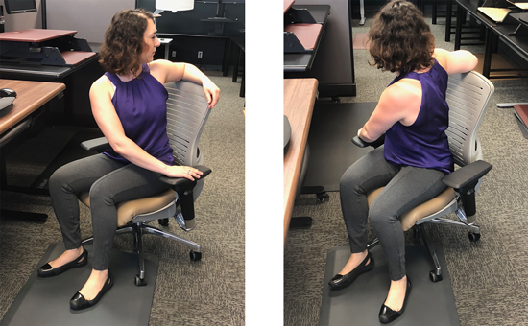
Torso Stretch, or Trunk Rotation
Start in a seated position with the feet flat on the floor.
Contract the abs and gently rotate the torso towards the right.
Use your hands on the armrest or seat of the chair to help deepen the stretch.
Only twist as far as you comfortably can and keep the back straight while keeping the hips square.
Hold for 10 to 30 seconds and repeat on the other side.
Repeat five to 10 times on each side.
Notes:
https://www.healthline.com/health/deskercise#arms
https://www.google.com/imgres?imgurl=https%3A%2F%2Fi.ytimg.com%2Fvi%2F3g95hw1QMmY%2Fmaxresdefault.jpg&imgrefurl=https%3A%2F%2Fgmb.io%2Fshoulder-mobility%2F&tbnid=wHlJ7erLFyF1fM&vet=12ahUKEwjXvffjxsP0AhUOWq0KHRrpBfEQMygHegUIARDDAg..i&docid=Y-03gZrwwUIO3M&w=1280&h=720&q=exercise%20that%20can%20be%20done%20at%20your%20desk%20for%20shoulder%20mobility&ved=2ahUKEwjXvffjxsP0AhUOWq0KHRrpBfEQMygHegUIARDDAgAt desk: https://youtu.be/eRafOyVq2H8
At home: https://youtu.be/HNbQHHV8co0?t=8

Slide 37
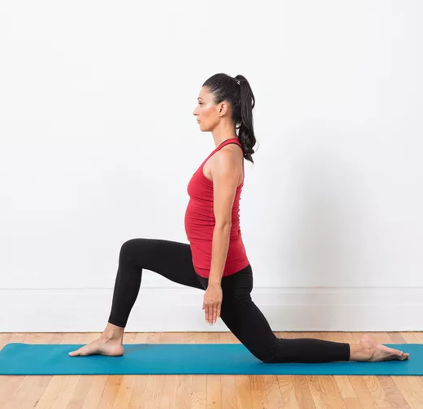
Hip flexor stretch
Start in a standing position.
Take the right leg back a few feet.
Bend the back knee, in a lunge position, and lower both knees until you feel a stretch in the front of the right hip.
Squeeze the glutes of the back leg to deepen the stretch.
Hold for 10 to 30 seconds and repeat on the other side.
Repeat five to 10 times on each side.
Notes:
https://www.healthline.com/health/deskercise#arms
https://www.google.com/imgres?imgurl=https%3A%2F%2Fi.ytimg.com%2Fvi%2F3g95hw1QMmY%2Fmaxresdefault.jpg&imgrefurl=https%3A%2F%2Fgmb.io%2Fshoulder-mobility%2F&tbnid=wHlJ7erLFyF1fM&vet=12ahUKEwjXvffjxsP0AhUOWq0KHRrpBfEQMygHegUIARDDAg..i&docid=Y-03gZrwwUIO3M&w=1280&h=720&q=exercise%20that%20can%20be%20done%20at%20your%20desk%20for%20shoulder%20mobility&ved=2ahUKEwjXvffjxsP0AhUOWq0KHRrpBfEQMygHegUIARDDAgAt desk: https://youtu.be/eRafOyVq2H8
At home: https://youtu.be/HNbQHHV8co0?t=8

Slide 38
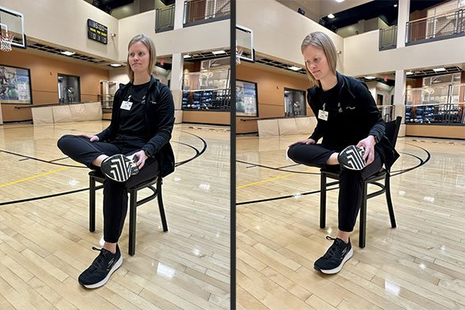
Seated Figure-4 Hip stretch
Sit on a chair with both feet flat on the ground.
Place your right ankle over your left knee, creating a "4" shape.
Gently press down on your right knee while keeping your spine straight.
Hold for 15–30 seconds and repeat on the other side.
Notes:
https://www.healthline.com/health/deskercise#arms
https://www.google.com/imgres?imgurl=https%3A%2F%2Fi.ytimg.com%2Fvi%2F3g95hw1QMmY%2Fmaxresdefault.jpg&imgrefurl=https%3A%2F%2Fgmb.io%2Fshoulder-mobility%2F&tbnid=wHlJ7erLFyF1fM&vet=12ahUKEwjXvffjxsP0AhUOWq0KHRrpBfEQMygHegUIARDDAg..i&docid=Y-03gZrwwUIO3M&w=1280&h=720&q=exercise%20that%20can%20be%20done%20at%20your%20desk%20for%20shoulder%20mobility&ved=2ahUKEwjXvffjxsP0AhUOWq0KHRrpBfEQMygHegUIARDDAgAt desk: https://youtu.be/eRafOyVq2H8
At home: https://youtu.be/HNbQHHV8co0?t=8

Slide 39
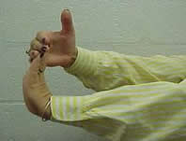
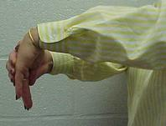
Wrist Stretch
Raise the arm straight out in front of the body
With the palm facing down, slowly bend the wrist downwards
Using the other hand, gently pull the stretching hand back towards the body
Hold this position for 15 to 30 seconds
Straighten the wrist again
Repeat twice
Do two more sets of 3 repetitions

Slide 40

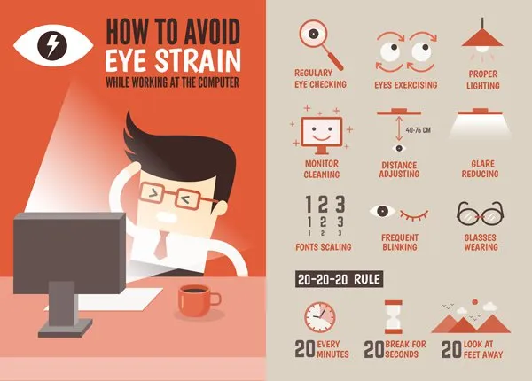
Eye Strain Prevention

Slide 41
Additional Tips
Make sure your mouse is close by and easy to use.
Position your keyboard correctly.
Placing it directly in front of you.
Your wrist should be extended straight but not bent up or down.
Use a wrist pad or desk pad.
Stretch your fingers/wrist regularly throughout the day.
Keep your fingers in line with your forearm.
Strengthen the muscles in your hand, wrist and forearm.
Try squeezing a tennis ball 25 times.
Make a fist with our hands and then bend your wrist forward and back using only your hand.

Slide 42
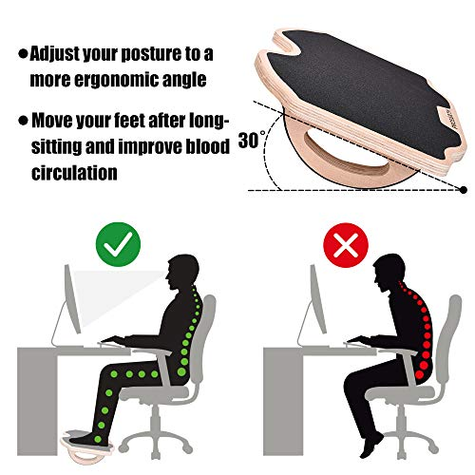
Additional Tips continued…
“Look with your eyes.”
Set notifications/reminders to get up and take break.
Purchase a footrest.
Most important thing to remember about RSI: REPETITIVE
Add as much variety to your work practice.

Slide 43

When to seek medical advice
Problems different than your “usual”.
Weakness
Persistent (lasting more than 2-3 days) or worsening symptoms.
Symptoms that disrupt your work or home life.

Slide 44

Key Takeaways
Prevention is important.
Start your day right and make adjustment to your workstation.
Always be aware of your desk posture.
Remember to take breaks regularly and stretch when you can.
Always seek medical advice, if your ‘usual’ pain changes or you have developed weakness.

Slide 45


Questions??

Slide 46

Michele L. Lanning D.O.
Email: mlanning@cas.org
LinkedIn Profile: Michele Parsley-Lanning D.O.
Notes:
LinkedIn: https://www.linkedin.com/in/michele-parsley-lanning-d-o-6ab030a5/

Slide 47
References
https://www.aacom.org/become-a-doctor/about-osteopathic-medicine
Osteopathic Manipulative Medicine: A Functional Approach to Pain
https://musculoskeletalkey.com/osteopathic-manipulative-medicine-a-functional-approach-to-pain/
Computer Ergonomics: How to Protect Yourself from Strain and Pain
https://uhs.umich.edu/computerergonomics#:~:text=Modify%20Your%20Body%20Mechanics,-Do%20you%20wear&text=Sit%20%22tall%2C%22%20aligning%20your,your%20hands%20off%20the%20mouse.
ERGONOMICS: Good for EVERYBODY
https://www.ors.od.nih.gov/sr/dohs/Documents/Ergonomics%20Good%20For%20Everybody.pdf
https://advancechiro.on.ca/common-computer-related-injuries/
https://www.rsipain.com/stretching-exercises.php
https://ergonomictrends.com/hand-wrist-exercises-computer-users/
https://www.onemedical.com/blog/healthy-living/repetitive-stress-stretches
bupa.co.uk/newsroom/ourviews/desk-stretches
https://info.bwc.ohio.gov/wps/portal/bwc/ site/safety/research-and-statistics/research-and-statistics/
https://consumer.healthday.com/encyclopedia/work-and-health-41/occupational-health-news-507/software-engineers-646385.html

